Slide 1
Data Visualization in Tableau

Slide 2
Measures vs. Dimensions
Measures
Dimensions
Quantitative
Can be used in calculations
Must be aggregated in some way
Discrete – whole number – blue
Continuous – decimal = green
Dates
Qualitative
Used to slice your data

Slide 3
Data Granularity
Level of detail
How aggregated your data is
Adjust the detail level on measures through use of dimensions

Slide 4


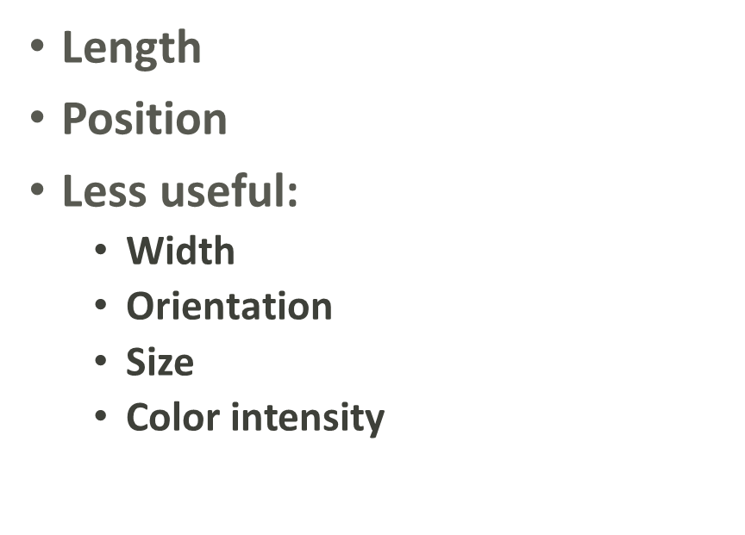
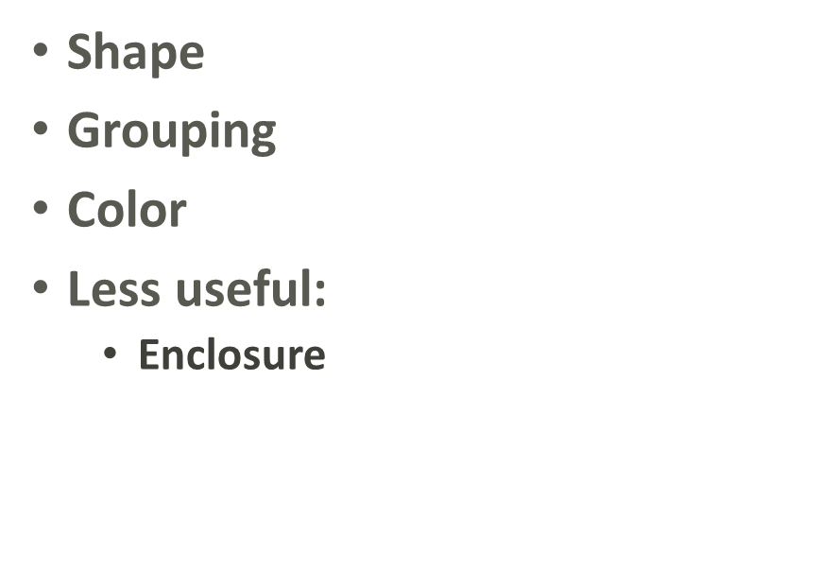
Pre-Attentive Attributes
Visual cues to help you process things in sensory memory

Slide 5
Joining vs. Blending
Joining
Blending
Have a matching key
No matching key

